Slide 1
Molecular Mechanisms Controlling the Circadian Rhythm
Pınar Oray, Eleonora Kazda

Slide 2
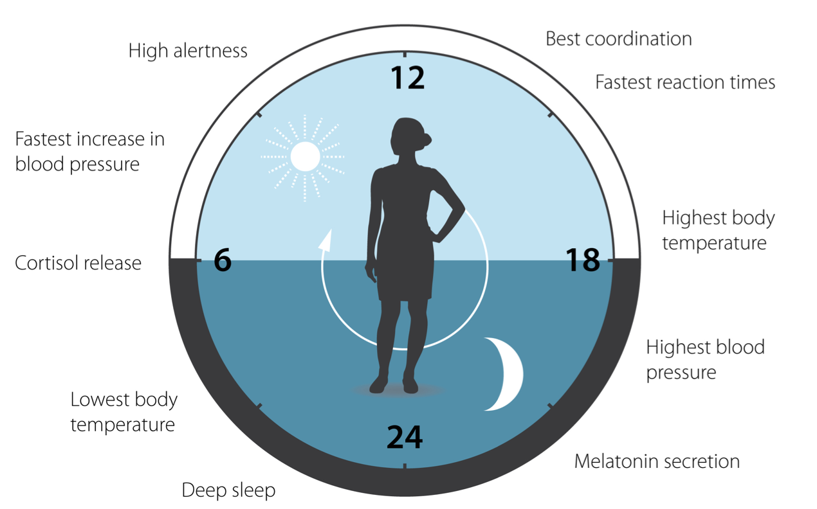
What is circadian rhythm?
It consists of:
Self-sustained 24 hour oscillator
Mechanisms linking the oscillator to external stimuli
Output mechanisms that regulate scheduling of physiological processes²
From circa dies in Latin - meaning around day
To adapt to daily environmental light and temperature changes, most organisms evolved an internal biological clock that anticipates day/night cycles and helps them optimize their physiology and behavior¹
^{1,2} https://www.nobelprize.org/uploads/2018/06/advanced-medicineprize2017.pdf
Notes:
We want to start by explaining what is circadian rhythm.
Circadian as a word comes from circa diem in Latin, meaning around day. This rhythm is created by an internal biological clock that optimizes the physiology and behaviour of organisms around one Earth day. It is an evolutionary trait that helps organisms adapt to daily changes in envirınmental light and temperature on our planet.
This clock is a self-sustained 24 hour oscillator with multiple mechanisms, some linking the oscillator to external stimuli and some that help regulate physiological processes as influenced by our clock.

Slide 3
Historical milestones
1729
1930s
1971
1980s
De Mairan – Mimosa plant rhythms in darkness (first evidence of endogenous clock)
Bünning – Inherited circadian rhythms in plants
Benzer & Konopka – Identified period gene in Drosophila mutants (arrhythmic, short/long-period flies)
Hall, Rosbash & Young cloned period, revealing the first clock gene
https://www.nobelprize.org/uploads/2018/06/advanced-medicineprize2017.pdf

Slide 4
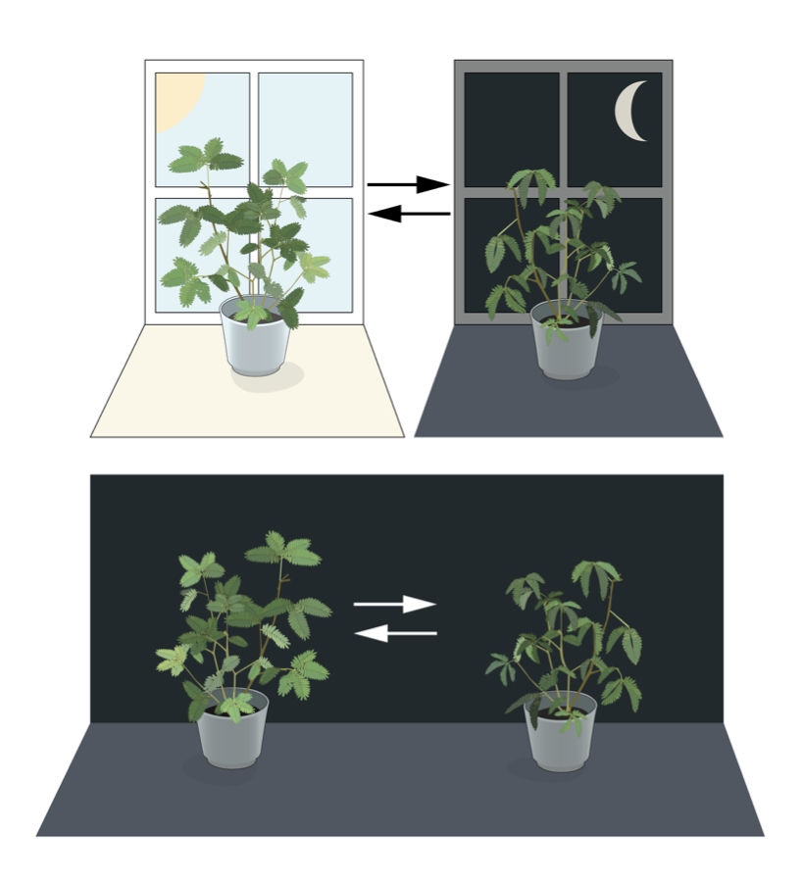
De Mairan - Mimosa plant rhythms in darkness
In 1729, Jean-Jacques d’Ortous de Mairan observed the mimosa plant's leaves opening and closing on a 24-hour cycle.
The leaves still followed this rhythm in complete darkness, indicating that the rhythm was internal rather than simply a response to external cues like light.
This was the first evidence of an endogenous biological clock, setting the foundation for the study of circadian rhythms.
https://www.nobelprize.org/uploads/2018/06/advanced-medicineprize2017.pdf

Slide 5
Bünning - Inherited circadian rhythms in plants
In the 1930s, Erwin Bünning demonstrated that circadian rhythms in plants could be inherited.
This discovery showed that circadian rhythms were not just environmental responses but were instead genetically encoded.
The ability to inherit and pass down rhythms highlighted that circadian control was intrinsic to organisms, not dependent on external conditions.
https://www.nobelprize.org/uploads/2018/06/advanced-medicineprize2017.pdf

Slide 6
Benzer & Konopka - Identified period gene in Drosophila mutants
In the 1970s, Benzer and Konopka used Drosophila (fruit flies) to explore the genetic basis of circadian rhythms.
They identified the period gene (per), which controls the rhythm of the flies.
Mutants of the period gene showed different behaviors:
Arrhythmic flies (no rhythm),
Short-period flies (faster rhythms),
Long-period flies (slower rhythms).
This was the first genetic evidence linking a specific gene to the regulation of circadian rhythms.
https://www.nobelprize.org/uploads/2018/06/advanced-medicineprize2017.pdf

Slide 7
Hall, Rosbash & Young – Cloning of the period Gene
In the 1980s-1990s, Michael Rosbash, Jeffrey Hall, and Michael Young cloned the period gene (per) in Drosophila.
This was a breakthrough, allowing scientists to study the molecular basis of circadian rhythms.
Their work led to the discovery that the per gene produces a protein that cycles in a feedback loop, crucial for maintaining circadian rhythms.
https://www.nobelprize.org/uploads/2018/06/advanced-medicineprize2017.pdf

Slide 8
TTFL Mechanism: How circadian clocks work
The circadian rhythm is orchestrated by a network of core ‘clock genes’ that are organised into transcription–translation feedback loops (TTFLs), producing oscillations with a period of approximately 24 hours.¹
Very generally, these clock genes (specifically PERIOD) are transcribed into mRNA, and translated into proteins. Then, these “clock proteins” accumulate and eventually inhibit their own gene’s transcription.²
The series of discoveries on fruit flies on this mechanism by Hall, Rosbash, Young (1984) won them the 2017 Nobel Prize of Medicine.
¹ https://www.sciencedirect.com/science/article/pii/S2213020915000294
² https://www.nobelprize.org/prizes/medicine/2017/press-release/
Notes:
We will first explain in detail the results obtained by Hall, Rosbach and Young about TTFL mechanism in fruit flies, which led them to win the 2017 Nobel Prize of Medicine.
The circadian rhythm is set by a network of clock genes working together, creating a transcription-translation network loops (TTFLs), that results in around 24 hour oscillations. We can imagine it as an on-off switch that controls its own power.
Core clock genes (like period and timeless) are transcribed into mRNA, translated into proteins, and those proteins then accumulate to repress their own gene transcription. That shuts down their own production until the next day.
This loop of “turn on → build up → turn off” is what keeps our internal clock ticking every 24 hours.

Slide 9
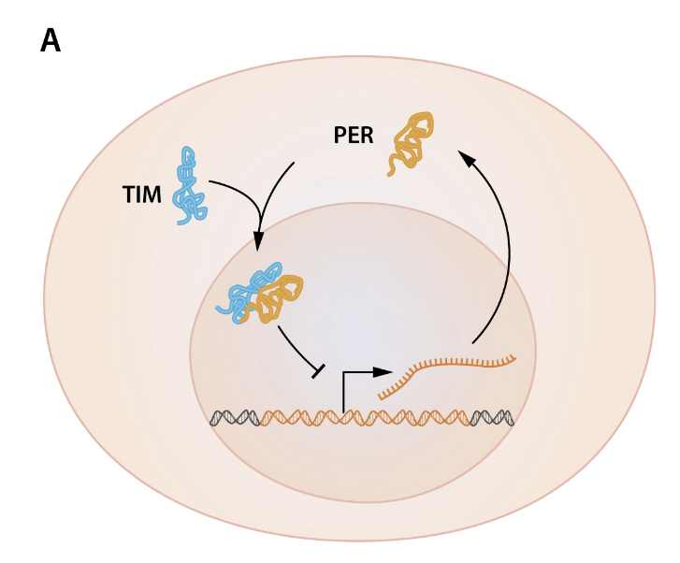
Nighttime: Gene suppression
At night, PERIOD and TIMELESS genes are transcribed, producing PER and TIM proteins, with PER protein accumulating several hours after the peak in period mRNA. TIM protein also oscillates and is critical for PER stability.
TIM binds to PER, enabling PER nuclear accumulation and repression of per transcription. PER-TIM complex accumulates in the cytoplasm early in the night.
CLOCK (CLK) and CYCLE (CYC) are two transcription factors encoded by the clock and cycle genes, activate transcription of per and tim.
Later in the night, the PER-TIM complex moves into the nucleus.
Inside the nucleus, PER-TIM inhibits CLOCK-CYCLE activators, blocking transcription of per and tim.
This inhibition is the start of the negative feedback loop.
https://www.nobelprize.org/uploads/2018/06/advanced-medicineprize2017.pdf
Notes:
In Drosophila, evening arrives and per mRNA starts to accumulate in the cytoplasm, but the first waves of PER protein are unstable, so they get phosphorylated and degraded by DBT (encoded by doubletime), and this creates a critical delay between mRNA and protein peaks in cytoplasm. Without this delay, the transcription and translation processes are too fast to create a cycle long enough.
As TIM protein, encoded by TIMELESS, starts to accumulate too, TIM binds PER, shielding it from DBT and allowing the resulting PER–TIM complex to accumulate in the cytoplasm.
Late in the night, these complexes translocate into the nucleus and inhibit CLOCK–CYCLE activatory, suppressing PERIOD, TIMELESS and other genes activated by clock-cycle..
This repression phase creates the negative feedback that halts new clock gene expression until morning.

Slide 10
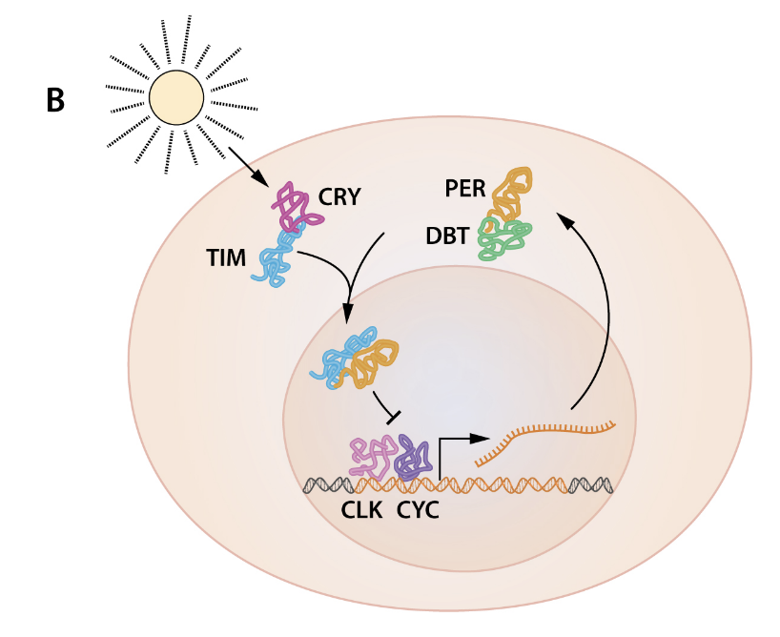
Daytime: degradation and restart
At sunrise, light can activate the protein product of the cryptochrome cry gene (CRY) and promote its binding to TIM, triggering rapid degradation of it.¹
Without TIM, PER becomes vulnerable to DBT kinase, encoded by DOUBLETIME gene. DBT phosphorylates PER, leading to PER degradation.
DBT-mediated degradation causes a delay between per mRNA production and PER protein accumulation, ensuring the ~24-hour cycle. Otherwise, the translation and the transcription is too fast to form 24 hour oscillations.
PER degradation lifts repression, allowing CLOCK-CYCLE to activate transcription again. This restarts the loop, and the circadian cycle.
https://www.nobelprize.org/uploads/2018/06/advanced-medicineprize2017.pdf
¹ https://pubmed.ncbi.nlm.nih.gov/8596937/
Notes:
With first light, in flies, photoreceptive CRY protein, encoded by CRYPTOCHROME, binds TIM and triggers its rapid degradation. Unprotected PER is then progressively phosphorylated by DBT, which flags it for destruction.
These degradations of PER and TIM lifts repression on CLOCK–CYCLE activators , allowing them to restart PERIOD and TIMELESS transcription.
These light-driven and kinase-mediated degradations each morning reset the feedback loop, ensuring the oscillator completes one full ~24-hour cycle.

Slide 11
All proteins playing a role in TTFL
 | Gene | When? | Role
PER | PERIOD | Early night | Blocks CLOCK–CYCLE activity in the nucleus
TIM | TIMELESS | Early night | Stabilizes PER and enables its nuclear entry
DBT kinase | DOUBLETIME | Daytime | Phosphorylates PER, delaying its accumulation
CRY | cryptochrome | Daytime | Drives TIM decay with light trigger (in flies)
Notes:
Here is a small summary of the proteins playing a role in fruit fly TTFL.
During the day, DBT helps stop the accumulation of PER protein, and this means the loop is not entering its negative feedback loop phase until the night, and at night TIM helps PER to start the loop again, stopping DBT from phosphorylating PER.

Slide 12
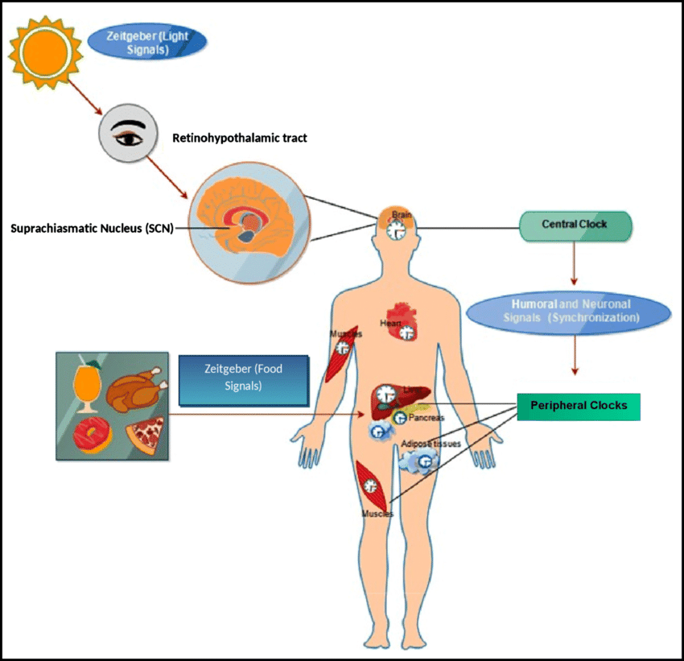
Synchronization & Entrainment
Master Clock (Suprachiasmatic Nucleus, SCN):
Located in the hypothalamus.
Receives light signals via the retina.
Synchronizes body rhythms via humoral factors and autonomic nervous system.
Peripheral Clocks:
Found in organs like liver, pancreas, etc.
Maintain their own rhythms but are synchronized by:
SCN signals
Local cues (feeding, physical activity, temperature)
https://www.researchgate.net/publication/341133029_Metabolic_implications_of_circadian_disruption
https://www.nobelprize.org/uploads/2018/06/advanced-medicineprize2017.pdf
Notes:
The circadian program is regulated at both a central and peripheral level.
In mammals, the central pacemaker is located in the suprachiasmatic nucleus (SCN) of the hypothalamus and functions as the master circadian clock.
The retina receives photic input and relays this information to the SCN, which synchronizes its own neuronal cellular clocks.
The central clock regulates circadian rhythms across the entire body via humoral factors and the peripheral autonomic nervous system.
However, the capacity for circadian gene expression is widespread throughout the body and most peripheral organs and tissues can express circadian oscillations in isolation.
Thus, the circadian system of an animal resembles a clock shop rather than a single clock.
This has raised the question of how so many clocks can be effectively synchronized.
Peripheral clocks can be synchronized both by the SCN and by environmental cues, including feeding, physical activity and temperature.
Peripheral clocks in different tissues control relevant physiological outputs, such as glucose production, fat storage and release of hormones.
These, in turn, function as time- keeping cues for clocks in tissues throughout the body, ultimately feeding back to the SCN.
Thus, the circadian system of an organism is a web of interconnected oscillators and feedback loops.
The relationship between the central and peripheral clocks, and the multiple ways by which local and external cues affect them, is an active area of research open to new discoveries

Slide 13
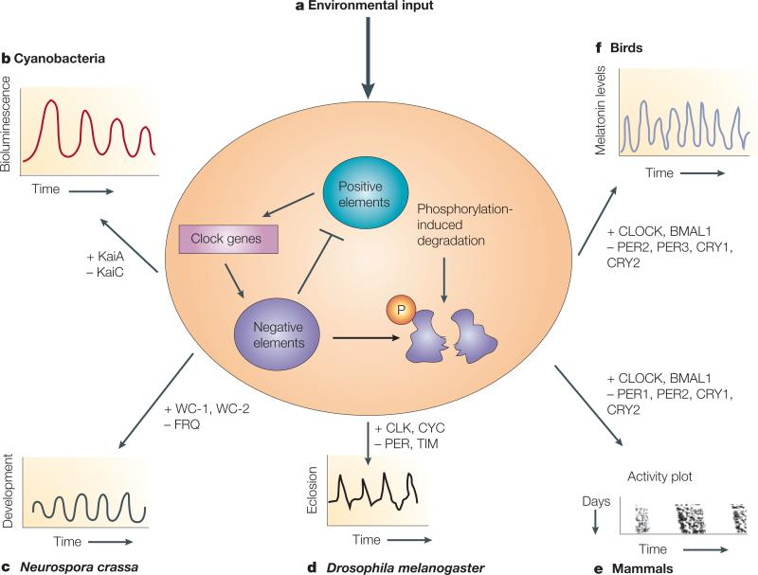
Circadian clocks across species
Cyanobacteria: A protein-only clock – KaiA/B/C cycle without making new RNA.
Fungi (Neurospora): FRQ protein builds up and then shuts down its own production.
Insects (Fruit fly): PER and TIM accumulate at night to silence their genes.
Mammals (Mouse, Human): PER teams up with CRY under CLOCK-BMAL1 control for a 24-h beat.
Plants (Arabidopsis): CCA1/LHY and TOC1 feedback loop times photosynthesis and growth.
The design of the system is the same: all of the species have interlocking feedback loops creating ~24 hour cycles.
https://pmc.ncbi.nlm.nih.gov/articles/PMC2735866/
Notes:
Although the core design is conserved, different organisms use distinct molecular components.
In cyanobacteria, KaiA, KaiB, and KaiC proteins undergo a phosphorylation–dephosphorylation cycle, generating ∼24 h rhythms without daily gene transcription.
In mammals,instead of TIM, we have CRY (compared with Drosophila). CLOCK–BMAL1 activate Per and Cry genes; PER–CRY complexes then inhibit their own activators until proteasomal degradation restarts transcription,
Even plants like Arabidopsis use interlocked loops of CCA1/LHY and TOC1 to regulate photosynthesis and growth each day.
Across all these species, interlocking positive and negative feedback elements yield a universal ~24 h oscillator

Slide 14
Health implications
Circadian clocks regulate:
Sleep, feeding, hormones, blood pressure, body temperature
Clock genes control:
Hormone rhythms (corticosterone, insulin)
Metabolism (gluconeogenesis, insulin sensitivity, blood glucose)
Circadian dysfunction linked to:
Sleep disorders, depression, cognitive decline, neurological diseases
Gene mutations can cause:
Sleep phase disorders (advanced/delayed cycles)
Chronic misalignment increases risk of:
Cancer, metabolic diseases, neurodegeneration, inflammation
Ongoing research:
Adjusting circadian clocks to improve health
https://www.nobelprize.org/uploads/2018/06/advanced-medicineprize2017.pdf
Notes:
Chronobiology has an impact on many aspects of our physiology.
For example, circadian clocks help to regulate sleep patterns, feeding behavior, hormone release, blood pressure and body temperature.
Molecular clocks also play critical roles locally in many tissues.
Ablation of clock genes in animal models results in arrhythmic production of hormones, such as corticosterone and insulin.
Clock genes also exert a profound influence on metabolism through the control of gluconeogenesis, insulin sensitivity and systemic oscillation of blood glucose.
Sleep is vital for normal brain function and circadian dysfunction has been linked to sleep disorders, as well as depression, bipolar disorder, cognitive function, memory formation and some neurological diseases.
In rare cases, sleep phase disorders are due to mutations in circadian clock genes resulting in advanced or delayed sleep-wake cycles.
Studies have indicated that chronic misalignment between our lifestyle and the rhythm dictated by our endogenous circadian clock may be associated with increased risk for various diseases including cancer, neurodegenerative diseases, metabolic disorders and inflammation.
Efforts are underway to develop approaches in chronobiology and pharmacology to modify the period, phase or amplitude of circadian clocks to improve human health.

Slide 15
Thank you for listening!
We are happy to take questions if you have any!

